Slide 1
FACE RECOGNITION USING IMAGE PROCESSING.
BATCH- IT-1
K.V.Hemanth -207Z1A1225
Sheldon Shaji -207Z1A1241
V.Nikil -207Z1A1248
Under Guidance :
Mr. T. Madhu

Slide 2

Implementation
Steps to Implement
Step-1 : Installing all the Packages Required.
Step-2 : Write the code in respective IDE.
Step-3 : Debug and Run the code.
Step-4 : The Output will be Displayed.

Slide 3
Source Code
Importing The Packages:
import face_recognition as fr
import cv2
import numpy as np
import os

Slide 4
Browsing the File
def browse_file():
global test_image_path
test_image_path = filedialog.askopenfilename(filetypes=[("Image files", "*.jpg *.jpeg *.png *.bmp")])
test_image_entry.delete(0, tk.END)
test_image_entry.insert(0, test_image_path)

Slide 5
Training
path = "./train/"
known_names = []
known_name_encodings = []
images = os.listdir(path)
for _ in images:
image = fr.load_image_file(path + _)
image_path = path + _
encoding = fr.face_encodings(image)[0]
known_name_encodings.append(encoding)
known_names.append(os.path.splitext(os.path.basename(image_path))[0].capitalize())

Slide 6
Test
test_image = "./test/test.jpg"
image = cv2.imread(test_image)
# image = cv2.cvtColor(image, cv2.COLOR_BGR2RGB)
face_locations = fr.face_locations(image)
face_encodings = fr.face_encodings(image, face_locations)
for (top, right, bottom, left), face_encoding in zip(face_locations, face_encodings):
matches = fr.compare_faces(known_name_encodings, face_encoding)
name = ""
face_distances = fr.face_distance(known_name_encodings, face_encoding)
best_match = np.argmin(face_distances)

Slide 7
if matches[best_match]:
name = known_names[best_match]
cv2.rectangle(image, (left, top), (right, bottom), (0, 0, 255), 2)
cv2.rectangle(image, (left, bottom - 15), (right, bottom), (0, 0, 255), cv2.FILLED)
font = cv2.FONT_HERSHEY_DUPLEX
cv2.putText(image, name, (left + 6, bottom - 6), font, 1.0, (255, 255, 255), 1)
Result
cv2.imshow("Result", image)
cv2.imwrite("./output.jpg", image)
cv2.waitKey(0)
cv2.destroyAllWindows()

Slide 8
GUI
# Create the main window
root = tk.Tk()
root.title("Face Recognition")
root.geometry("400x300")
# Test image selection
test_image_label = tk.Label(root, text="Select Test Image:")
test_image_label.pack()
test_image_entry = tk.Entry(root)
test_image_entry.pack()

Slide 9
browse_button = tk.Button(root, text="Browse", command=browse_file)
browse_button.pack()
browse_button.place(x=160,y=70)
# Recognize faces button
recognize_button = tk.Button(root, text="Recognize Faces", command=recognize_faces)
recognize_button.pack()
recognize_button.place(x=150,y=120)
root.mainloop()

Slide 10
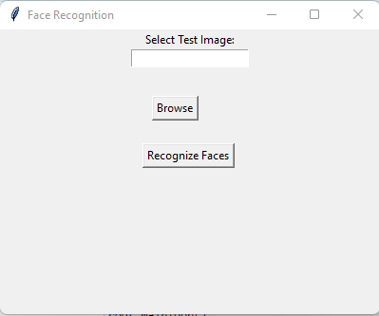
Output Screens

Slide 11
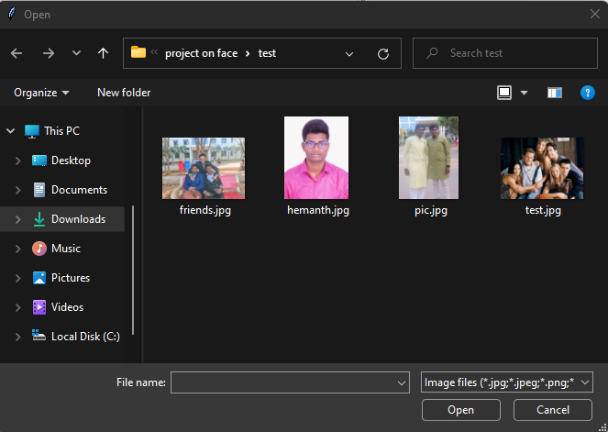

Slide 12
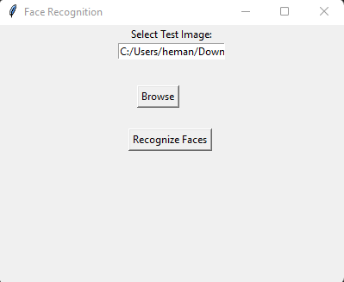

Slide 13
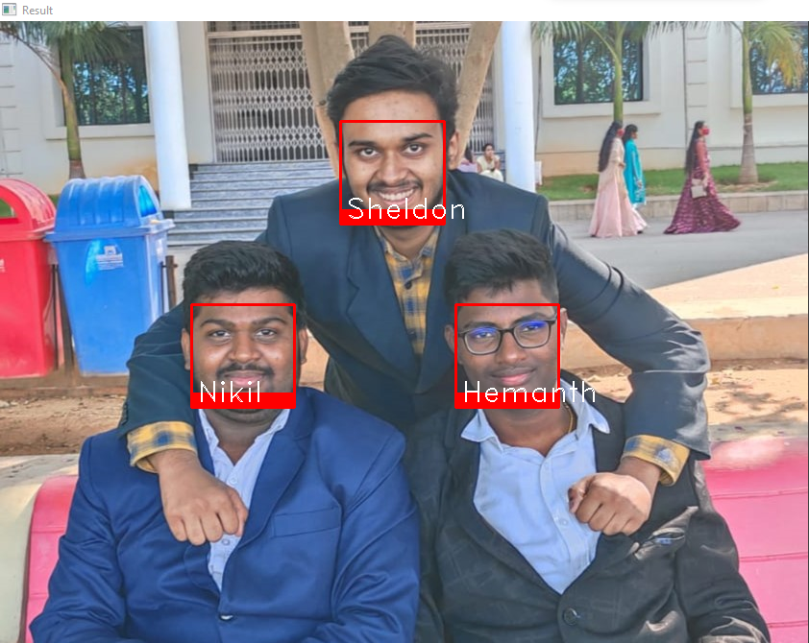

Slide 14
Test Cases
TEST CASE ID | TEST CASE DESCRIPTION | INPUTS | EXPECTED OUTPUT | ACTUAL OUTPUT | STATUS
1 | Train the Data | Import the images as we required. | Need to Train the data. | Reading data is done. | Success
2 | Train the Data | Importing the Blur Images. | It can’t be trained. | Images are not trained. | Success
3 | Detect facial features | Face bounding box region | Need to extract eye , mouth, nose contours | Feature extraction is done. | Success
4 | Browse Button | We need to provide the Test Image | Select the Image and click Enter. | Image will be Uploaded. | Success
5 | GUI | It will open a GUI application. | Window will be open. | Window Displayed. | Success

Slide 15
TEST CASE ID | TEST CASE DESCRIPTION | INPUTS | EXPECTED OUTPUT | ACTUAL OUTPUT | STATUS
6 | Test Image | We need to provide the Test Image Conditions. | The recognition of the image is done Successful. | The Image is Recognized. | Success
7 | Face recognition | Image depicting a face. | Face is recognized | Face is properly recognized | Success
8 | Compare the database | Face features are checked in database | Compared the face in database | Face compared successfully | Success
9 | Output Screen | The output of Test Image will be displayed. | Users face should be recognized. | User face is Recognized. | Success

